Slide 1
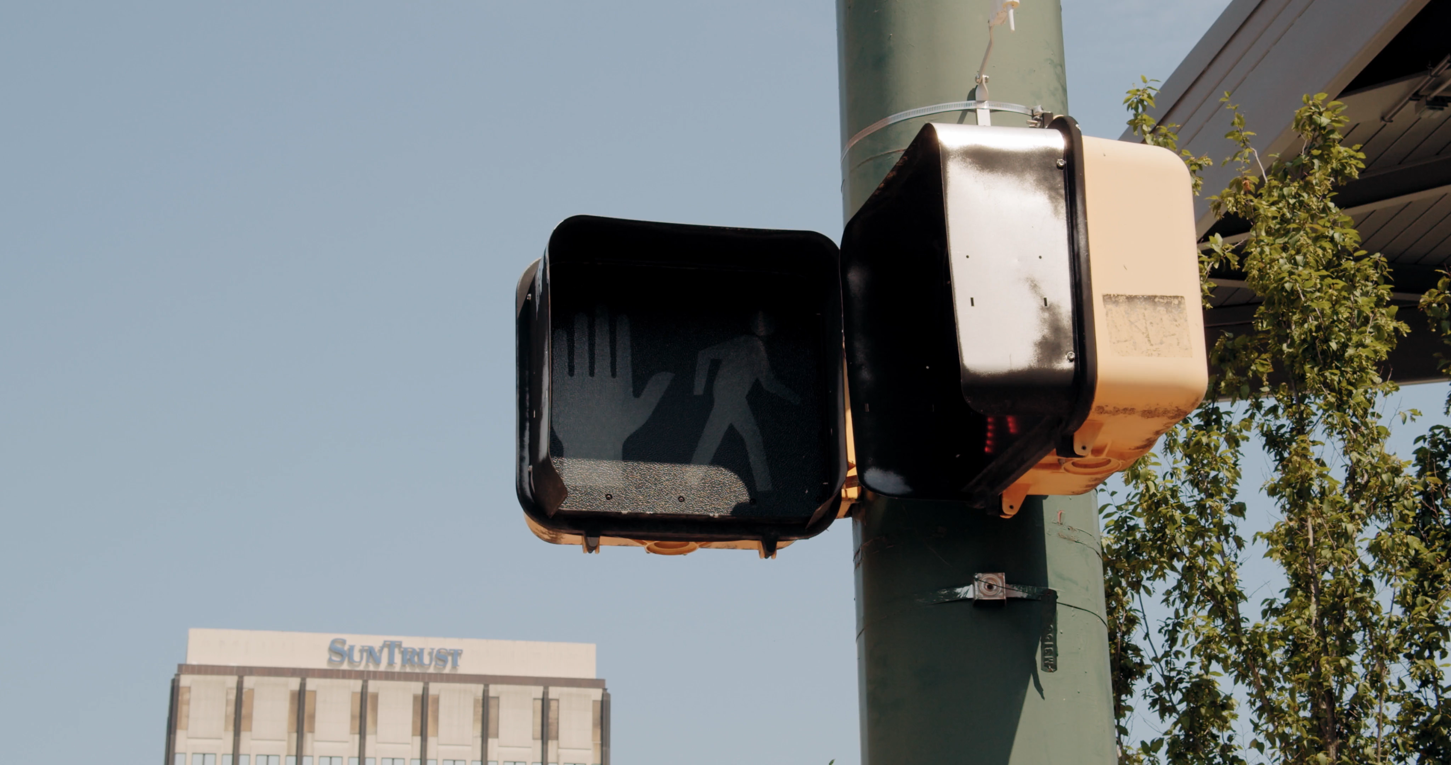
The German Traffic Sign Benchmark (GTSB)
by Daniel Ferreira & Guilherme Antunes
for TAA
at Universidade de Aveiro

Slide 2
GTSB - Index
Conclusions
05
Model performance and lessons learned
CNN
03
Deep CNNs, Structure and Application (LeNet-5)
Configs, Processing and Adjustments
04
Configurations and Preparations
Image Pre-Processing
Hyper-Parameter Adjustment
Context
01
Why is this project fit for purpose?
Data
02
What data did we work with?

Slide 3
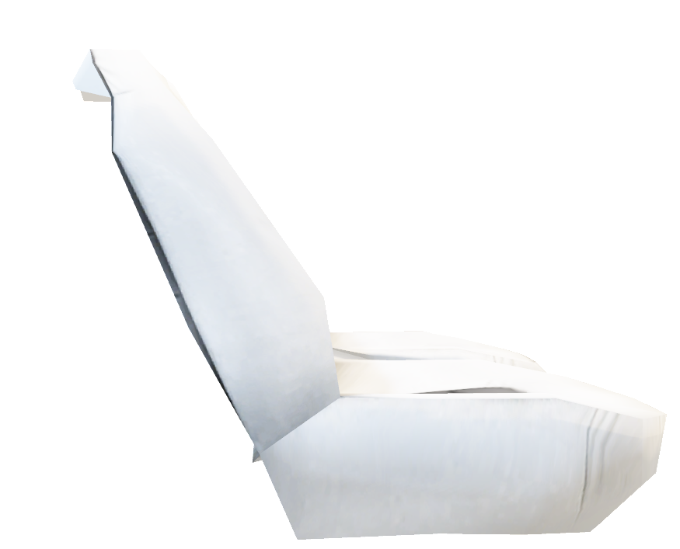
Context
01
A 2021 study shows that Autonomous Vehicles can have up to a 90% success rate in preventing avoidable accidents.
- Scanlon, J. M., Kusano, K. D., Engström, J., & Victor, T. (n.d.). Collision Avoidance Effectiveness of an Automated Driving System Using a Human Driver Behavior Reference Model in Reconstructed Fatal Collisions. Waymo, LLC.

Slide 4
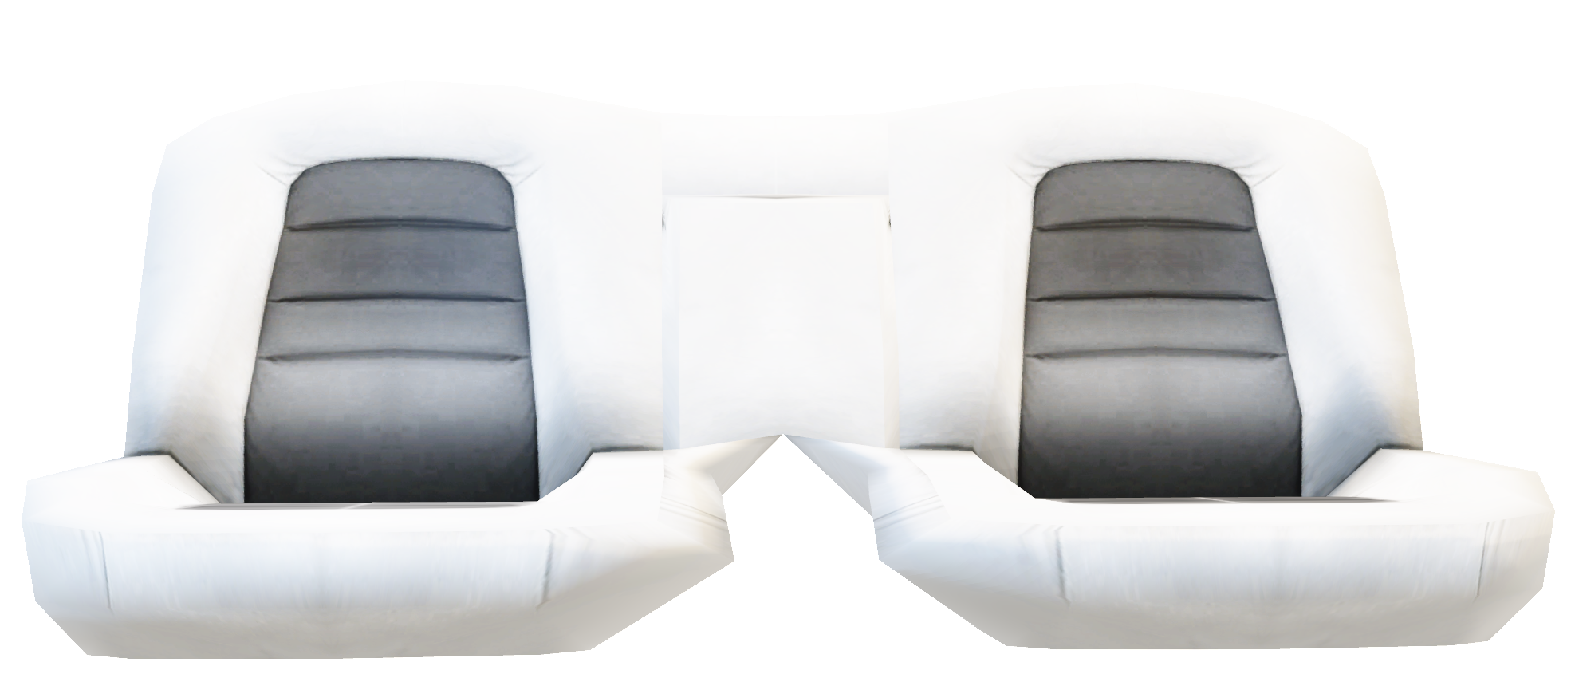
Context
01
For humans to take a backseat, machines must first be able to identify and understand road signs.

Slide 5
GTSB - Index
Conclusions
05
Model performance and lessons learned
CNN
03
Deep CNNs, Their Structure and Their Application (LeNet-5)
Configs, Processing and Adjustments
04
Configurations and Preparations
Image Pre-Processing
Hyper-Parameter Adjustment
Context
01
Why is this project fit for purpose?
Data
02
What data did we work with?

Slide 6
Data
02
Over 50 thousand images, with 43 different classes, divided into 3 sets

Slide 7
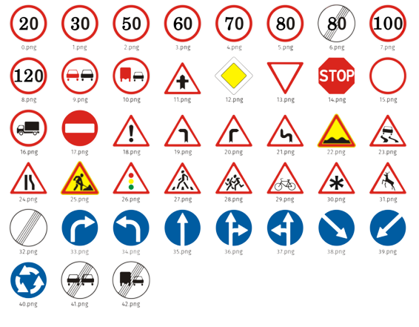
Data - Meta
02

Slide 8
Data - Test
02
12631 images, shuffled

Slide 9
Data - Train
02
39209 images, sorted

Slide 10
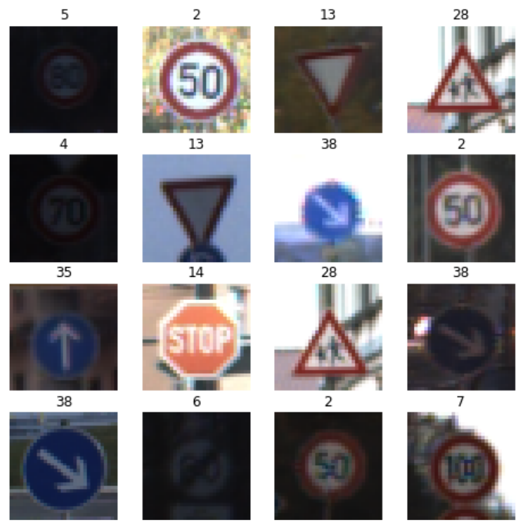
Data
02

Slide 11
GTSB - Index
Conclusions
05
Model performance and lessons learned
CNN
03
Deep CNNs, Their Structure and Their Application (LeNet-5)
Configs, Processing and Adjustments
04
Configurations and Preparations
Image Pre-Processing
Hyper-Parameter Adjustment
Context
01
Why is this project fit for purpose?
Data
02
What data did we work with?

Slide 12
CNN
Max Pool Layer
Applies element-wise local maximum detection, reduces overfitting and computational effort.
Fully Connected Layer
03
High-level, rational and feature-based pattern recognition.
Convolutional Layer
Softmax Layer
Applies filters to the input image or the output of the previous layer
Normalizes the previous output and converts it into a probability distribution over possible classes.
Flattening Convolutional Layer
Converts the last previous output into a 1-D vector.

Slide 13
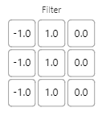
CNN – Convolutional Layer
03

Slide 14
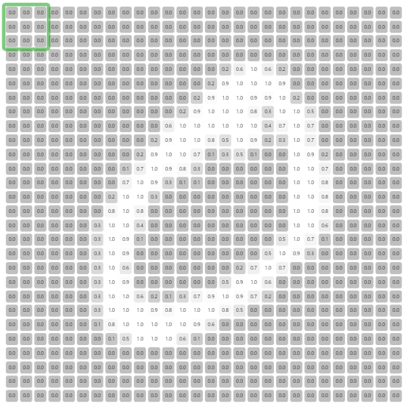
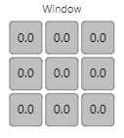
CNN – Convolutional Layer
03

Slide 15
CNN – Convolutional Layer
03

Slide 16
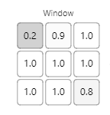
CNN – Convolutional Layer
03

Slide 17
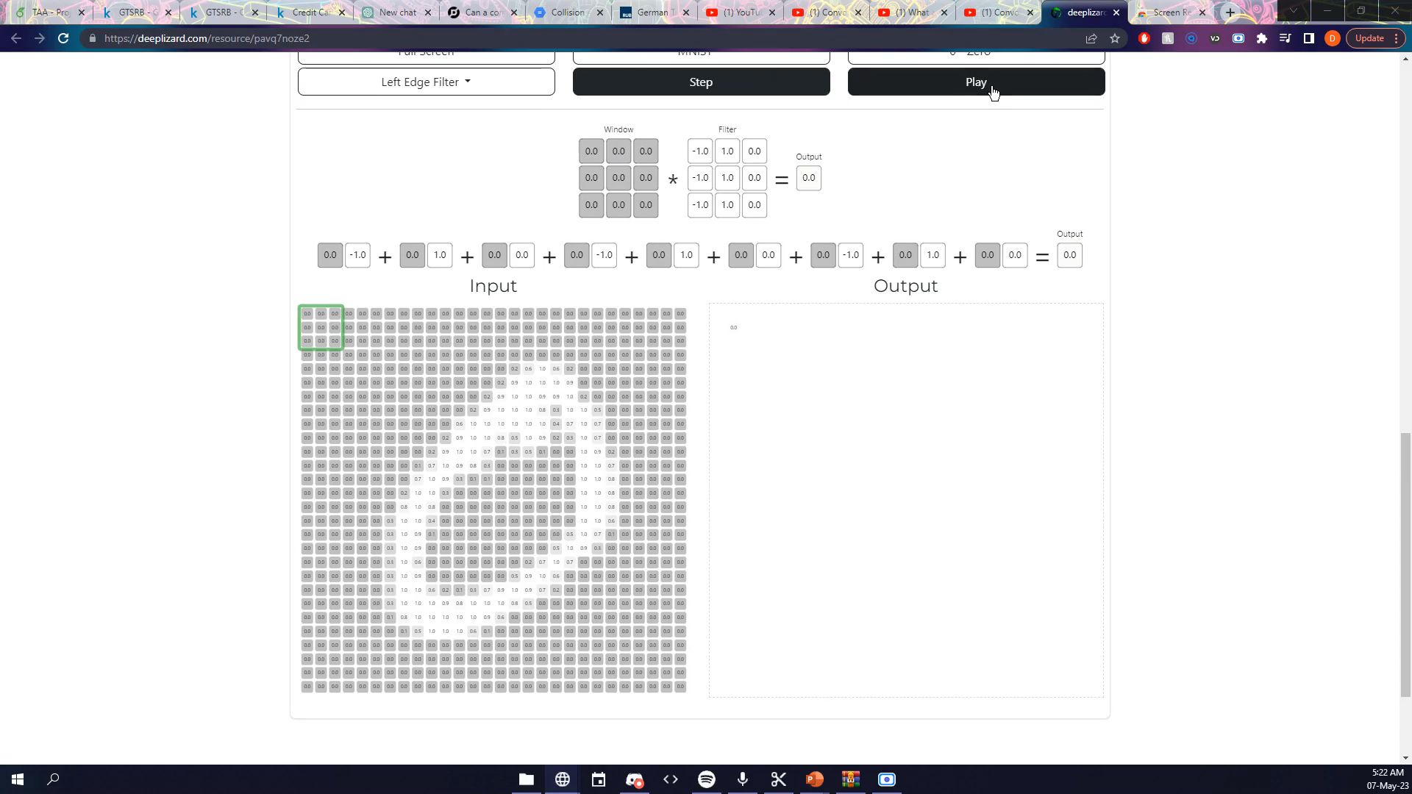
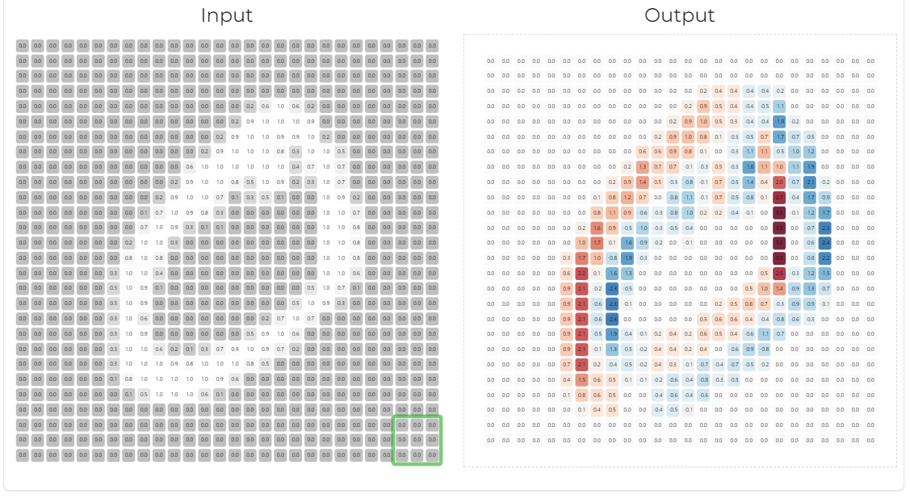
CNN – Convolutional Layer
03

Slide 18
CNN – Convolutional Layer
03
ReLU implies neutral and cold areas will be set to 0.

Slide 19
03
CNN – Convolutional Layer
Abstraction increases as layers progress

Slide 20
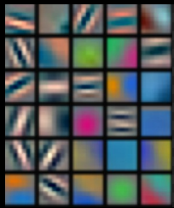
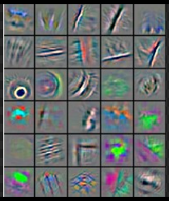
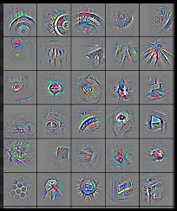
03
CNN – Convolutional Layer
Edges
Edge Types
Shapes
Objects
01
02
03
04
Abstraction increases as layers progress

Slide 21
GTSB - Index
Conclusions
05
Model performance and lessons learned
CNN
03
Deep CNNs, Their Structure and Their Application (LeNet-5)
Configs, Processing and Adjustments
04
Configurations and Preparations,
Image Pre-Processing,
Hyper-Parameter Adjustment
Context
01
Why is this project fit for purpose?
Data
02
What data did we work with?

Slide 22
Configs, Processing and Adjustments
04
Categorical Cross-Entropy
0.001
30
32
ReLU
ADAM
Loss Function
Activation Function
Opt. Function
Learning Rate
EPOCHs
Batch Size

Slide 23
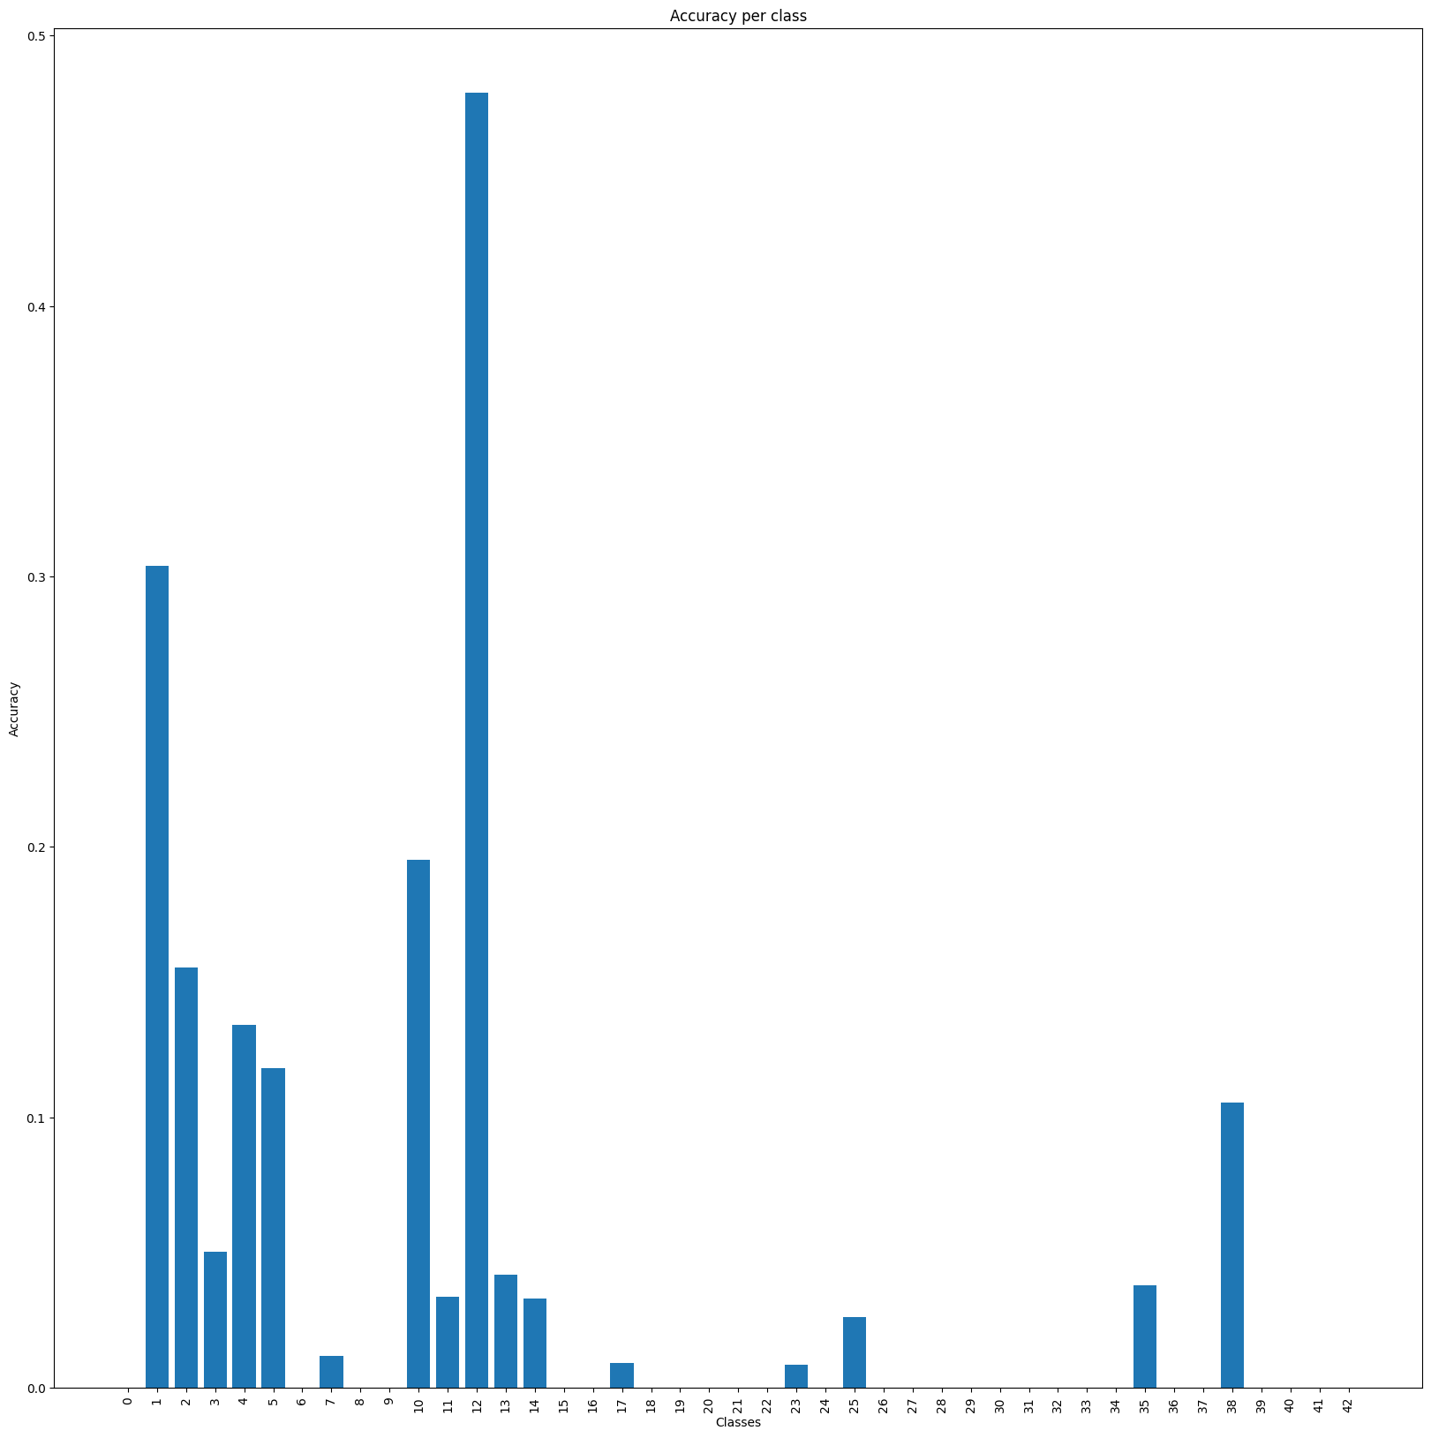
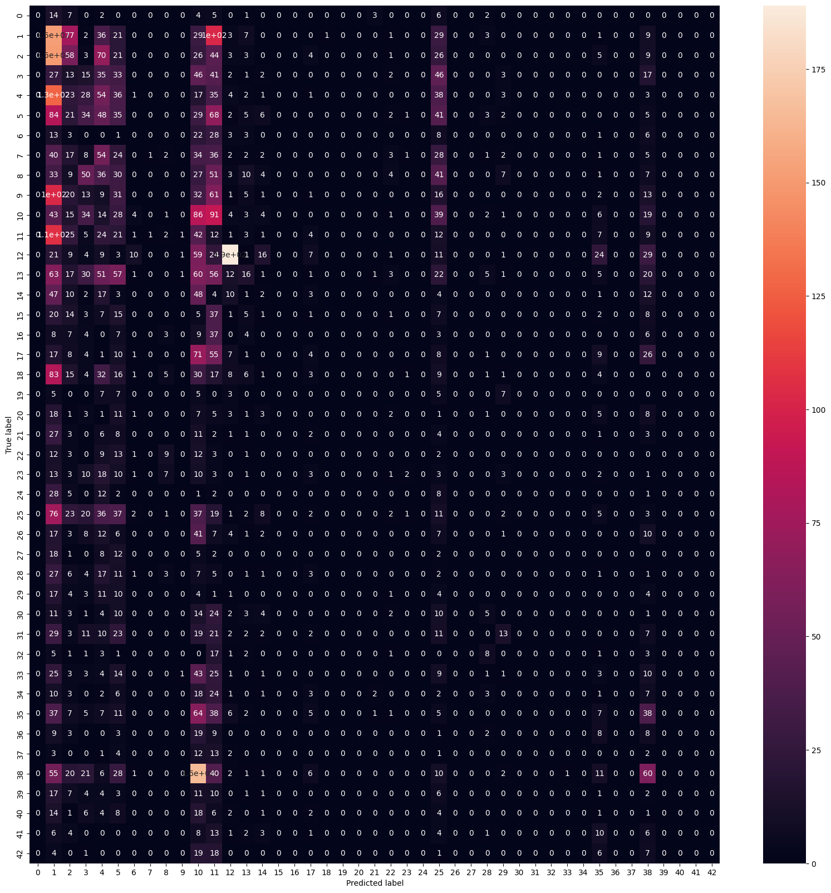
SVM – LBP (Sigmoid)
04

Slide 24
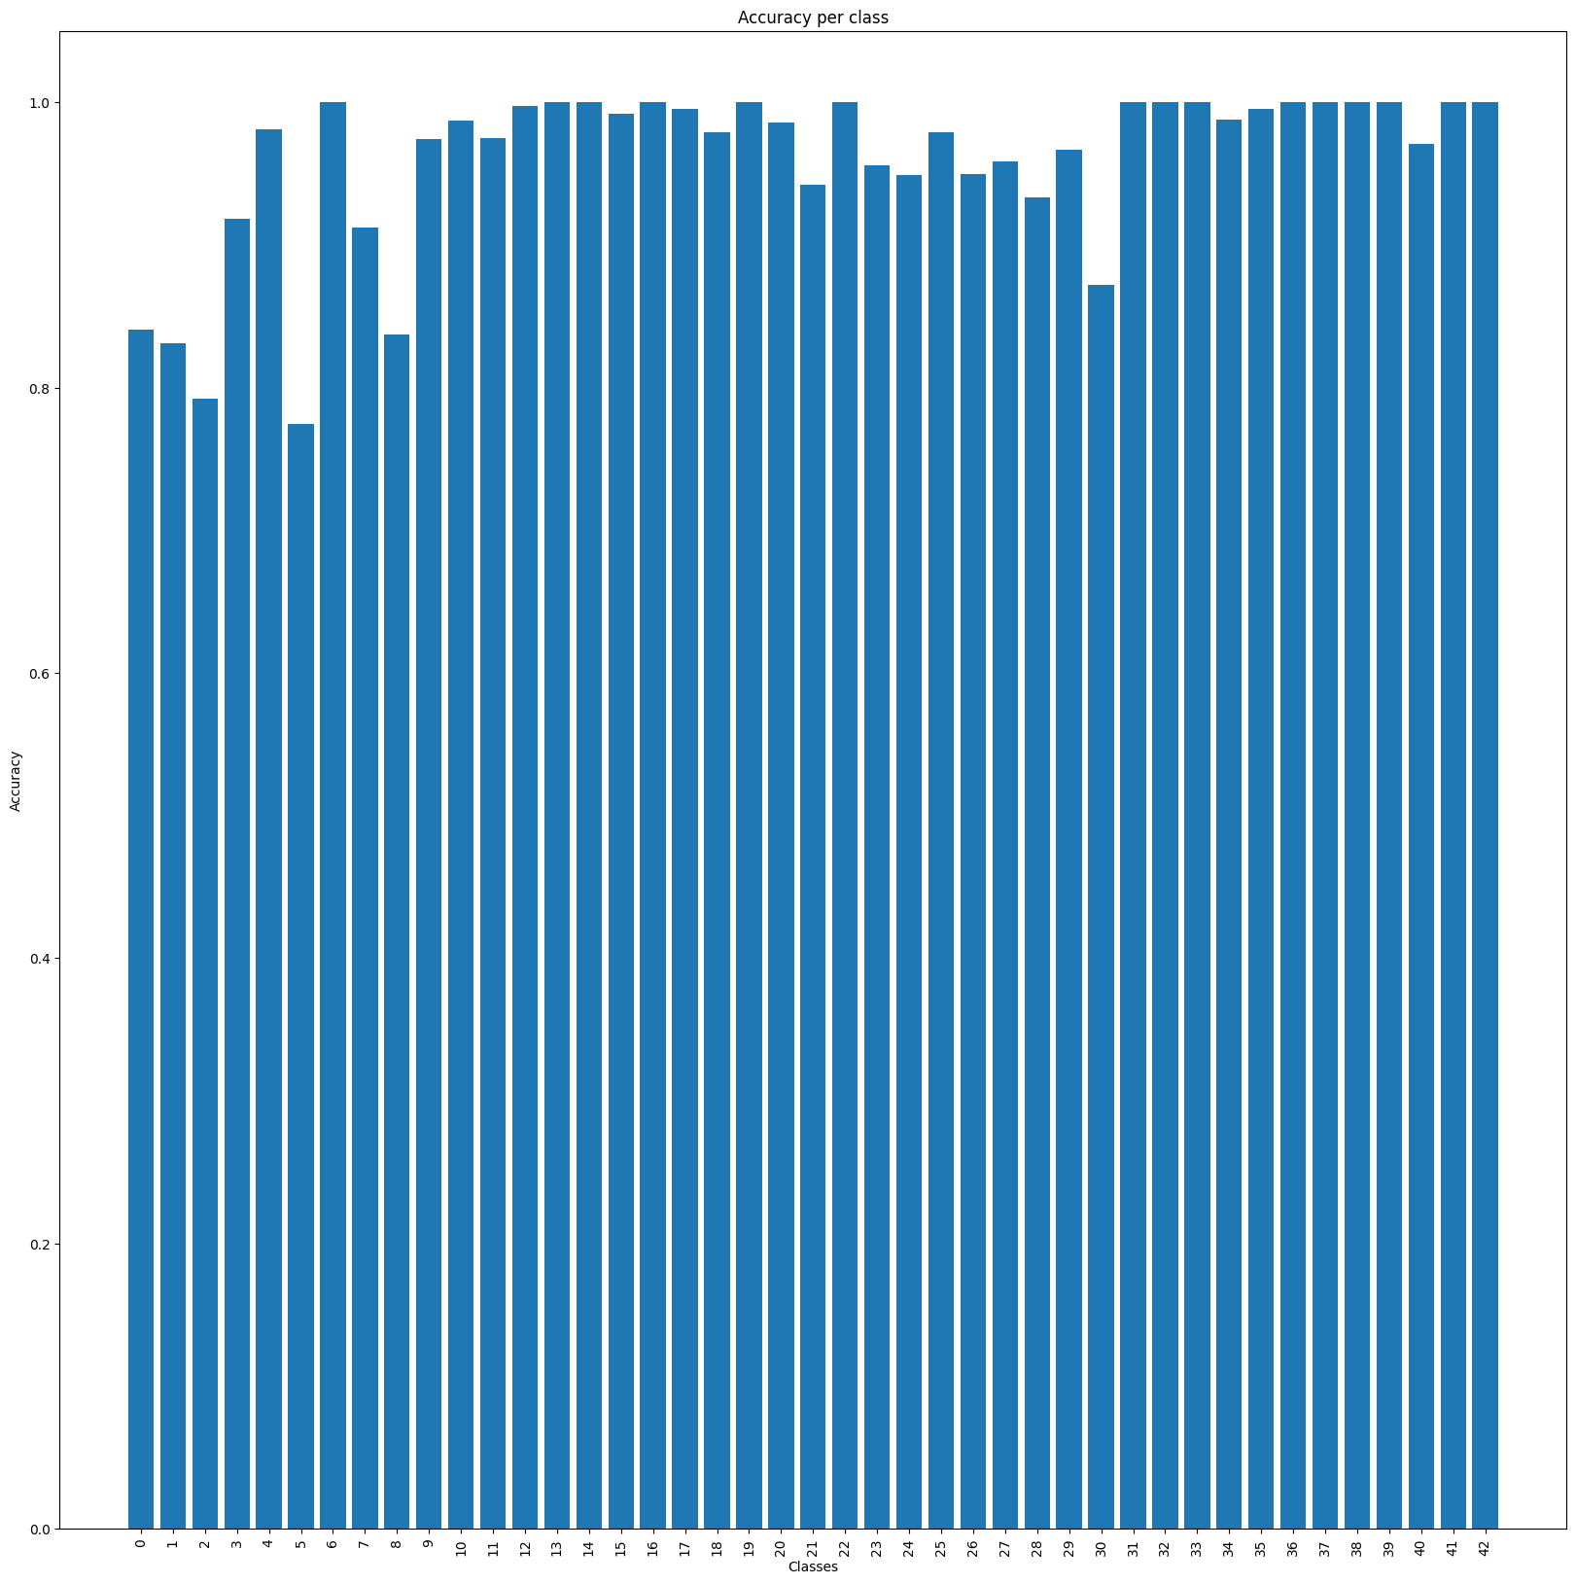
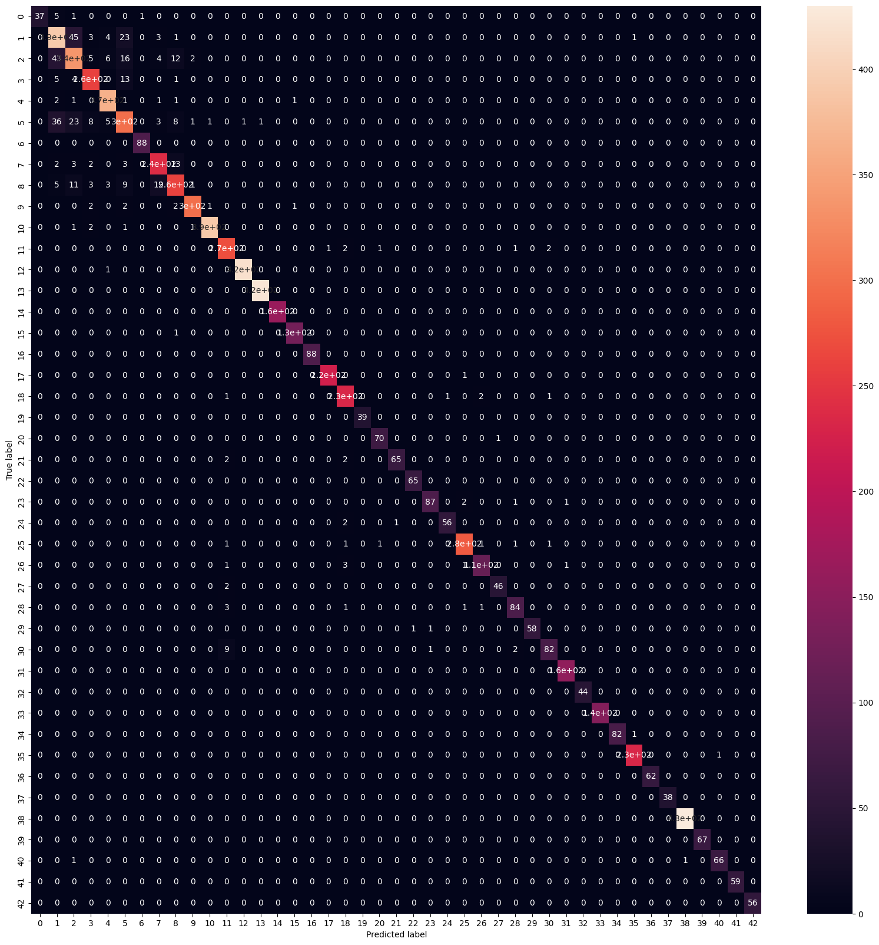
SVM – HOG (Linear, C=1, OVR)
04

Slide 25
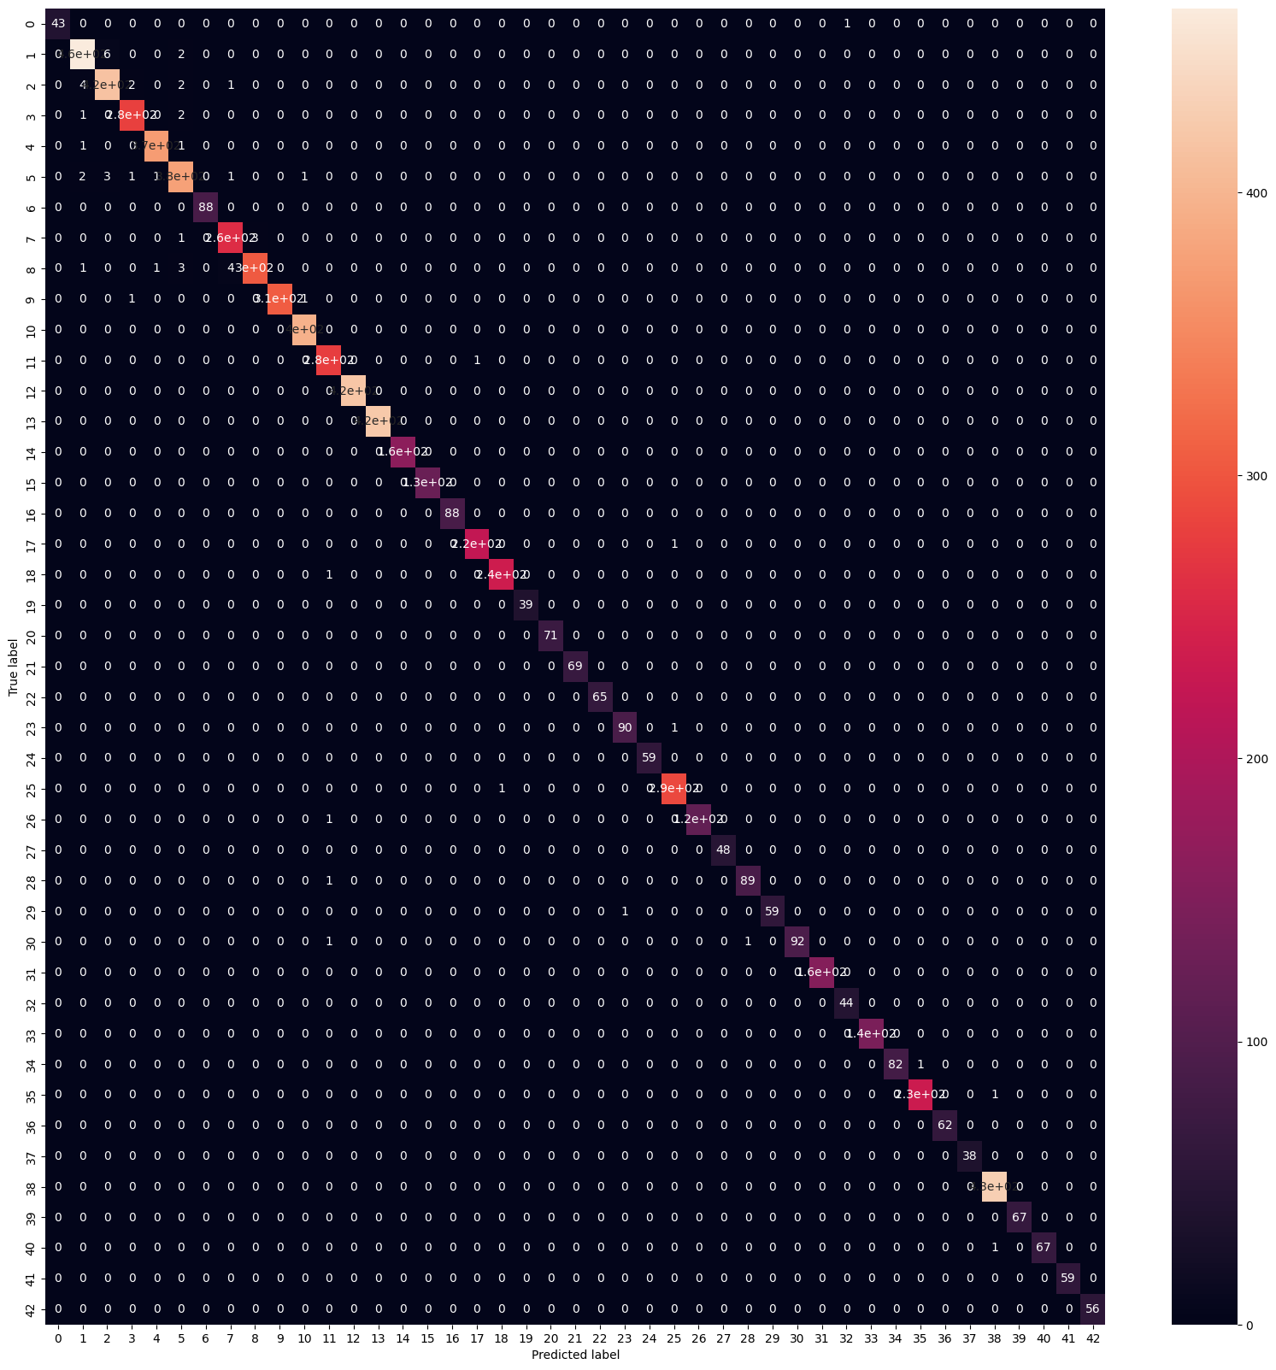
SVM – HOG (RBF, C=100, OVO)
04
>

Slide 26
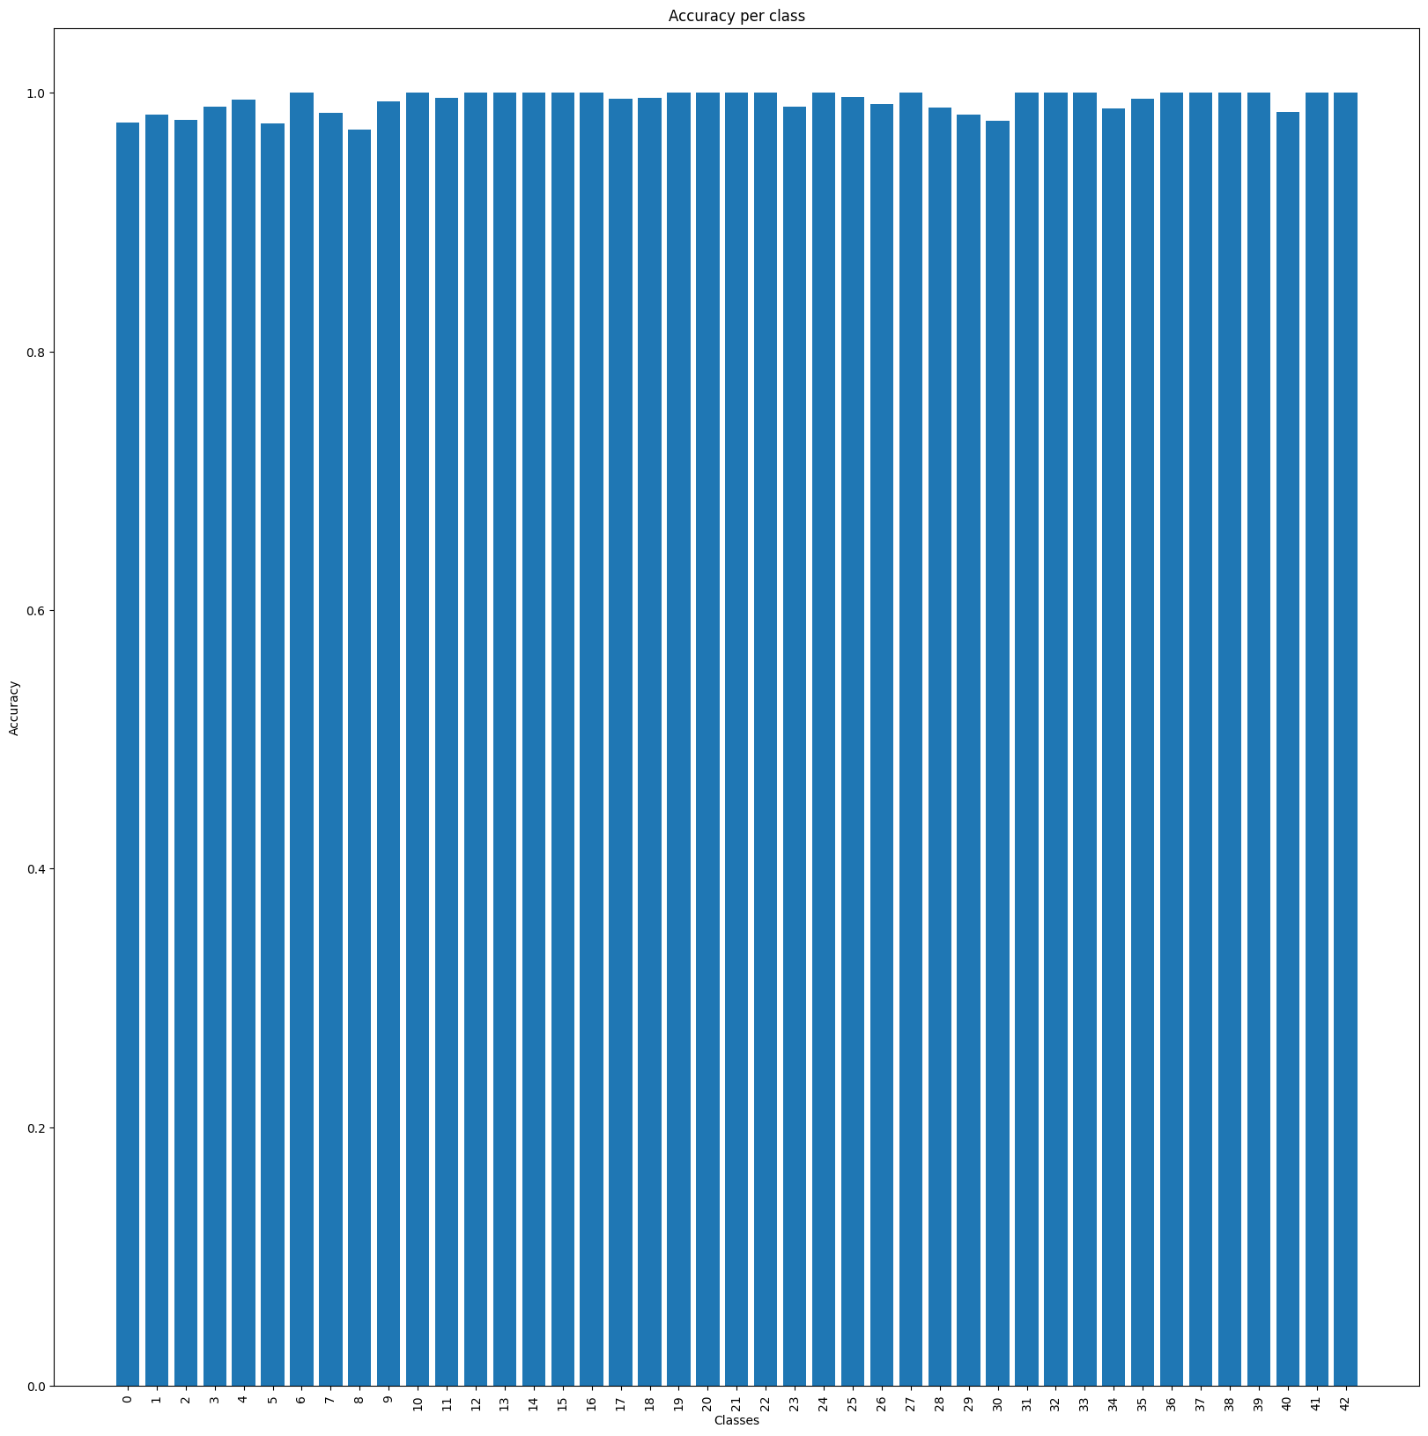
SVM – HOG (RBF, C=100, OVO)
04
>

Slide 27
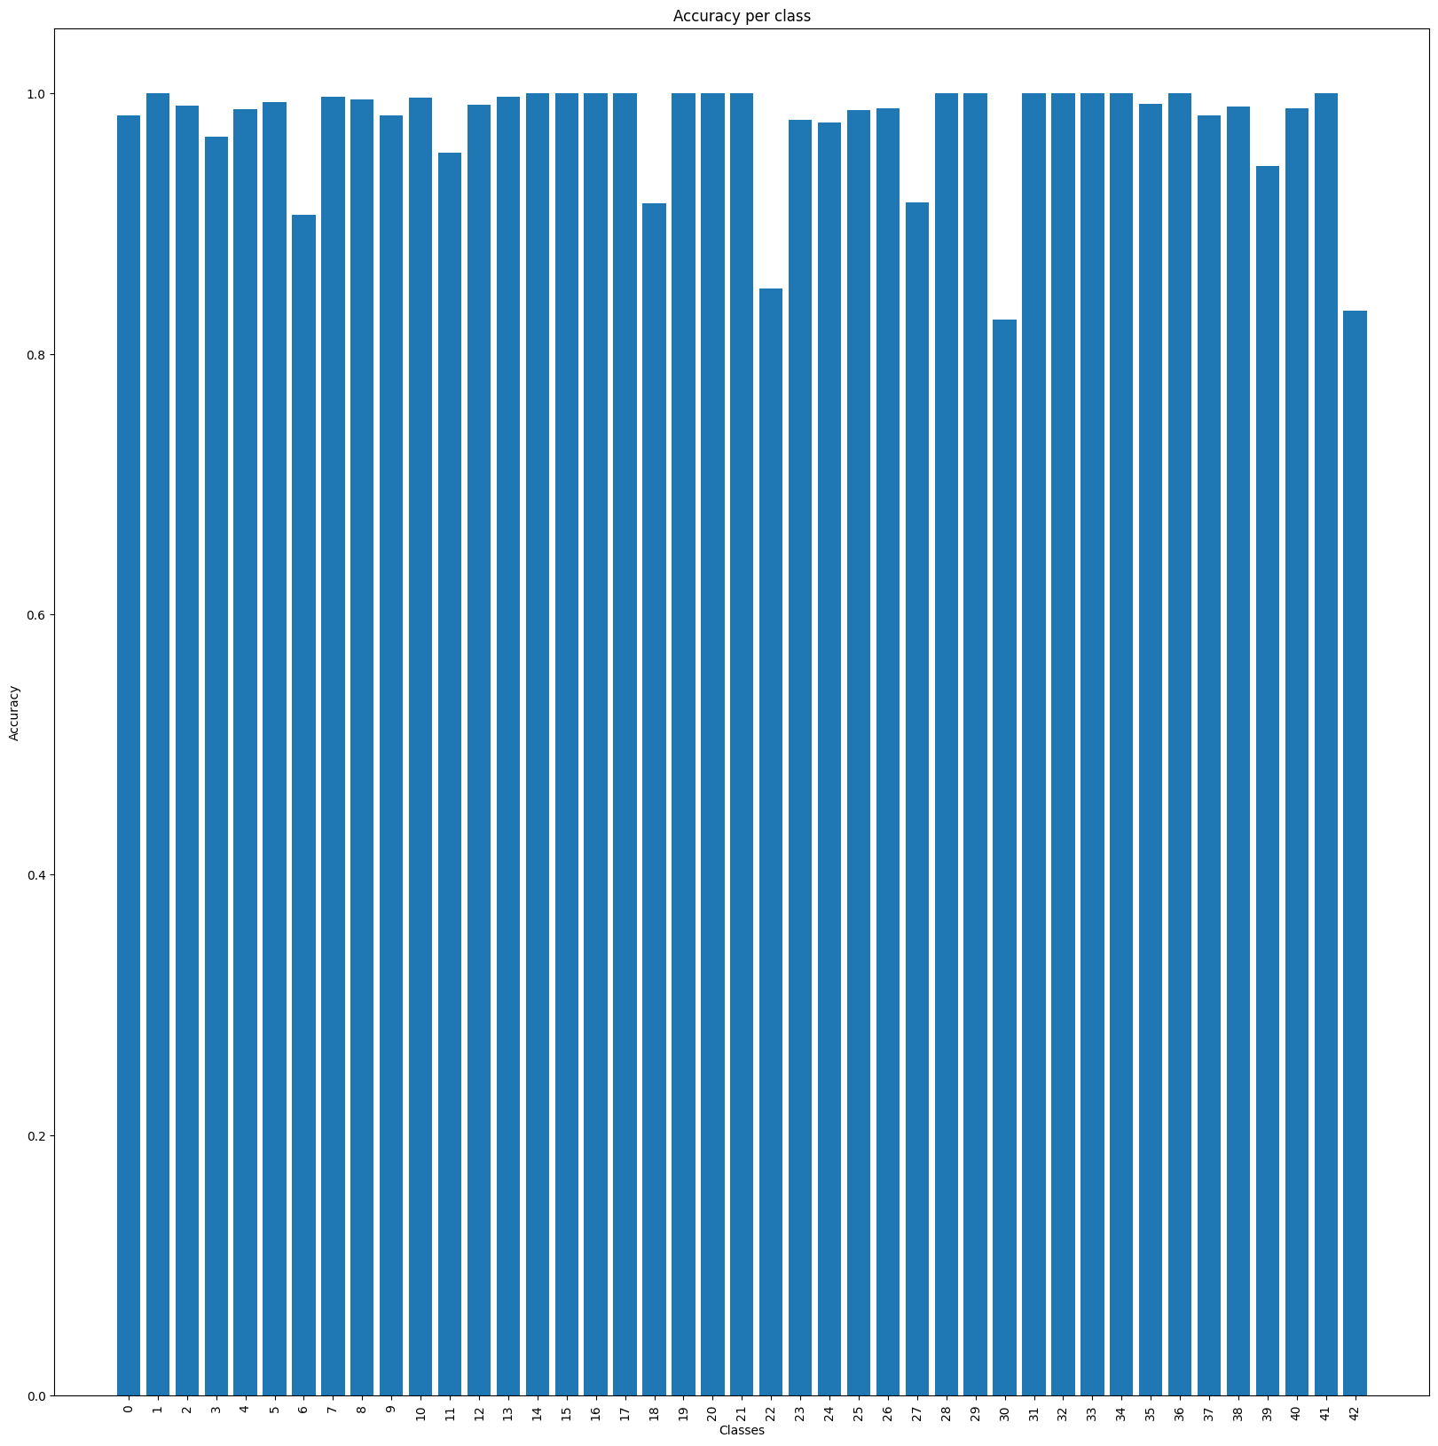

CNN LeNet5 – RGB
04

Slide 28
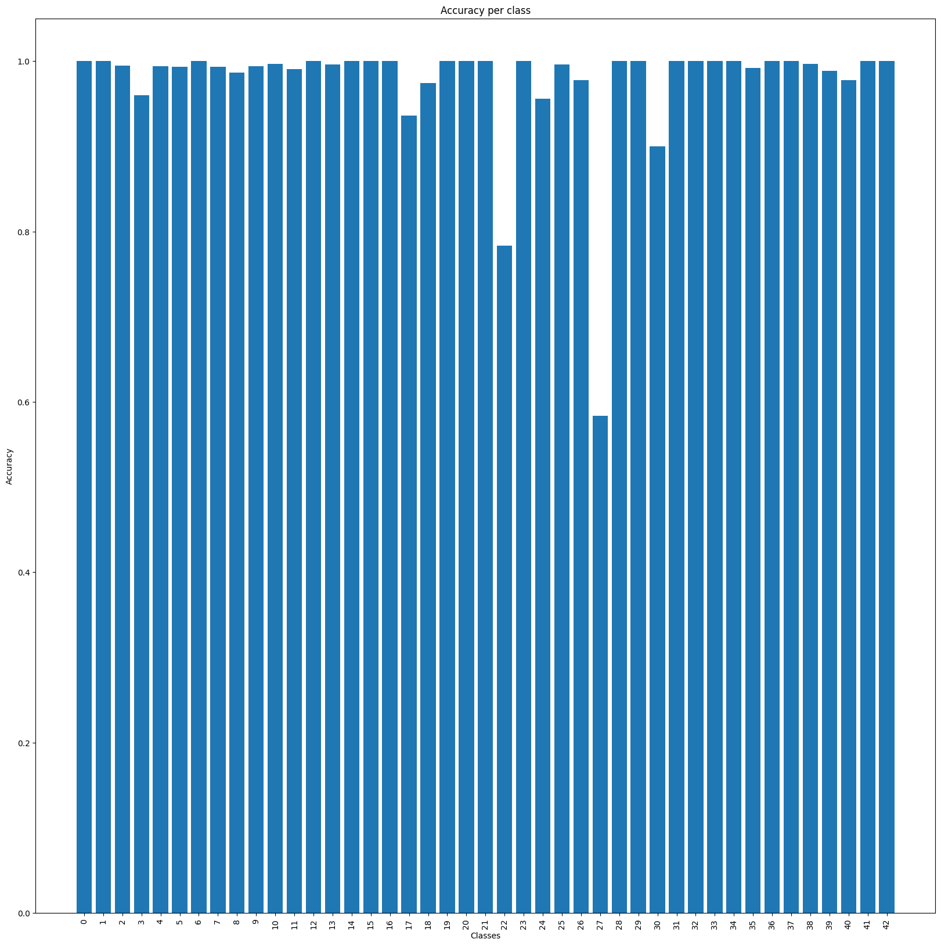

CNN LeNet5 – Gray Scale
04

Slide 29
GTSB - Index
Conclusions
05
Model performance and lessons learned
CNN
03
Deep CNNs, Their Structure and Their Application (LeNet-5)
Configs, Processing and Adjustments
04
Configurations and Preparations,
Image Pre-Processing,
Hyper-Parameter Adjustment
Context
01
Why is this project fit for purpose?
Data
02
What data did we work with?

Slide 30
Conclusions
05

